Slide 1

Fundamentals of RM
RM System and Process
Leadership in RM
Incident Investigation
RM Tools & Challenges
RM in Industry
People & Org.
Applications & Perspectives
On Becoming a Leader in Risk Management
ENGG404 - Lecture
Setting Expectations for Our Course Culture
ESRM ENGG404
1
Notes:
ENGG406 2015WENGG406 Lecture 00 - Day 1
1
ENGG404 Lecture 00 - Day 1
2012 Fall
1
1

Slide 2
Learning Outcomes of this Chapter:
Explain the learning format for this course (it is different!)
Explain the importance of culture towards course effectiveness.
Explain the professional expectations for in-class behaviours.
Explain “professionalism” in this course and in your engineering field of study.
Assess professionalism in yourself and in others.
Setting Expectations for Our Course Culture
2
Notes:
ENGG406 2015WENGG406 Lecture 00 - Day 1
2
2

Slide 3


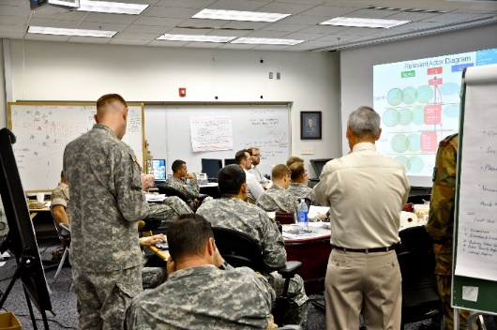



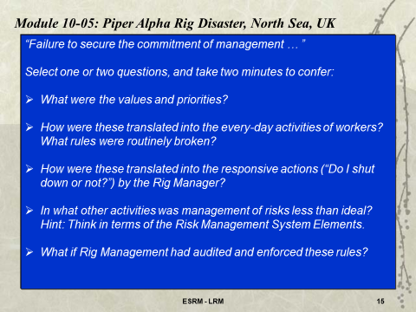

Blended Learning:
Q: What is Blended Learning?
A: Blended Learning is a combination of teaching and learning techniques: Reading, viewing on-line material, quizzes, traditional lectures, in-class active learning exercises.
Videos
In Class Activities
Q & A
Please Confer
Case Studies
Setting Expectations for Our Course Culture

Slide 4
Blended Learning:
Q: Why are we using Blended Learning?
A: We use Blended Learning because it is more efficient and more effective. Research demonstrates improved learning when students “engage” with the material.
Q: Why are the seminars mandatory?
A: The seminars are mandatory because they:
build essential competencies in professionalism, equity, and team-work,
guide the project teams to build leadership and teamwork skills, and
enable students to work on the project throughout the term in a paced manner, and producing a better project paper.
Setting Expectations for Our Course Culture

Slide 5
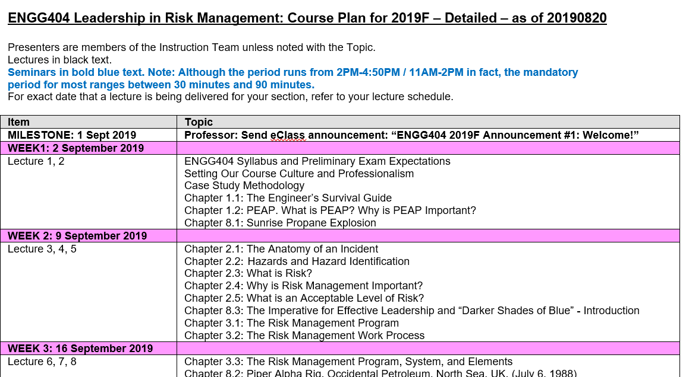
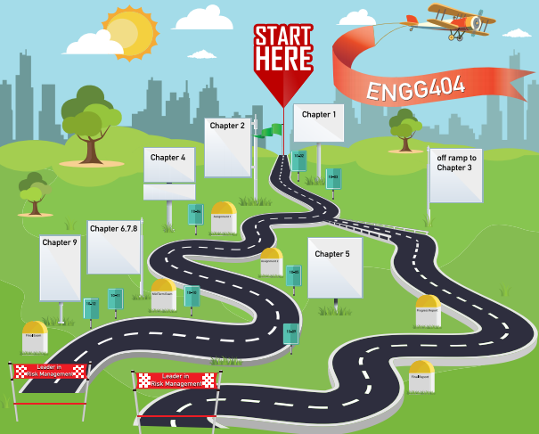
Blended Learning:
Q: I cannot see the big picture. How do all of these “modules” fit together?
A: Several resources:
The Course Plan: The order in which the chapters are presented
The Ribbon: The overview of how the chapters fit together
The graphical “road map”
The Textbook: detailed content of the topics
Setting Expectations for Our Course Culture

Slide 6
Expectations for Participation and Engagement:
Take Ownership of Your Learning!
We encourage you to transform from “getting by” to “excelling” in this course.
Knowing your responsibilities, what are you going to do differently this term?
Setting Expectations for Our Course Culture
6
Notes:
ENGG406 2015WENGG406 Lecture 00 - Day 1
6
6

Slide 7


Self-reflection:
What motivates you to be here?
Are you …
An eager, willing, and engaged participant?
On the fence?
A bystander?
A road-blocker?
A prisoner?
Setting Expectations for Our Course Culture
7
Notes:
7

Slide 8
What is Culture?
Culture is … “the way we do work around here.”
Demonstrated by behaviours of people in a class …
One critical competency in a successful culture is the ability to confer with others i.e. to collaborate.
Five opportunities to develop that competency - for an effective classroom culture follow!
Setting Expectations for Our Course Culture
8
Notes:
ENGG406 2015WENGG406 Lecture 00 - Day 1
8
8

Slide 9
Introduce Yourself!
My personal introduction to you demonstrates how …
Introduce yourself …
Awkward, difficult
Why is introducing yourself important?
It raises your visibility …
… shows that you care about your professional relationships,
… demonstrates professionalism.
Setting Expectations for Our Course Culture
9
Notes:
ENGG406 2015WENGG406 Lecture 00 - Day 1
9
9

Slide 10


Practice Respect and Diversity:
"Research shows that the more diverse your organization, the better your decision making, the better your operation in general. We're looking for the best candidates and we're not pushing anybody aside.” Kyle Dubas, Toronto Maple Leafs GM
Wickenheiser joins Maple Leafs
Setting Expectations for Our Course Culture
10
Notes:
ENGG406 2015WENGG406 Lecture 00 - Day 1
10
10

Slide 11
Practice Respect and Diversity:
Diversity is more than ethnic background
Diversity is:
Education, experience, expertise …
The “way” of seeing and understanding a problem ..
The “way” of approaching and solving a problem …
The team project environment presents an opportunity for you to adapt to a diverse workplace.
Professionalism, ethics, and plain courtesy (good manners) go a long way.
Setting Expectations for Our Course Culture
11
Notes:
ENGG406 2015WENGG406 Lecture 00 - Day 1
11
11

Slide 12
How to Excel in This Course:
Our job is to facilitate learning and to enable you to succeed.
The student’s job is to … engage in learning … put effort into this course.
Setting Expectations for Our Course Culture
12

Slide 13
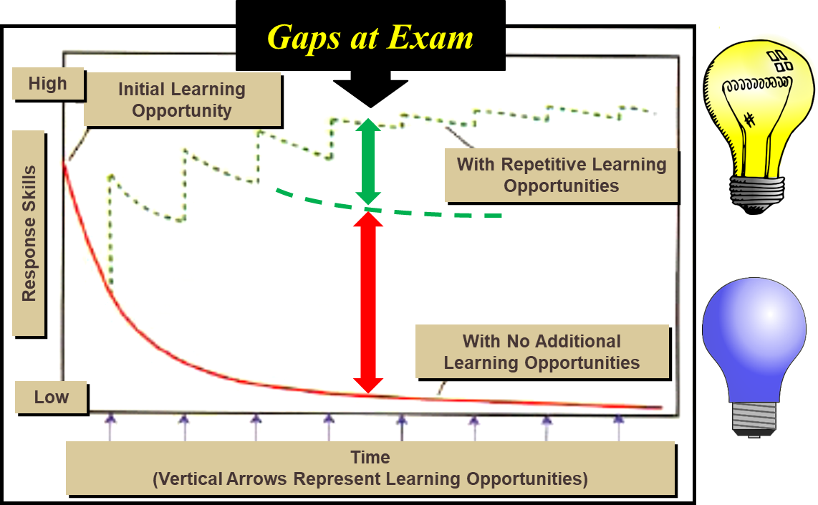
How to Excel in This Course:
Imagine two students … “bright” and “not so bright”
Comparison their study habits and learning gaps …
Setting Expectations for Our Course Culture
13

Slide 14
Business Meeting Rules & Expectations for Class Behaviours
Fairly explicit!
You can expect business meeting rules in all workplaces, written and unwritten:
Rules for common courtesy:
If you are expecting that important phone call …
If you are late for the lecture …
Avoid disruptive behaviours:
Impolite arrivals / departures
Doing an assignment, on-line shopping, checking the game scores …
Rules for effective learning:
Give your full and undivided attention …
Take notes (PPTs or pen & paper) …
No electronic devices (other than for in-class learning) …
Setting Expectations for Our Course Culture
14
Notes:
ENGG406 2015WENGG406 Lecture 00 - Day 1
14
14

Slide 15
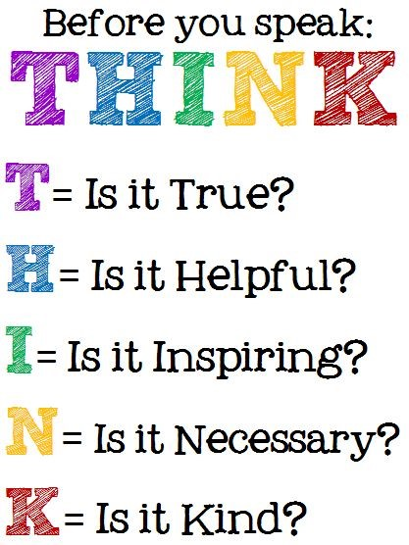
Our Mentimeter Ground Rules:
Before you Menti!
Honest? Sincere?
Builds on the question?
Thoughtful? Intellectual?
Meaningful?
Considerate? Polite? Respectful?
Setting Expectations for Our Course Culture
15
Notes:
15

Slide 16
Business Meeting Rules & Expectations for Class Behaviours
Think about the kinds of behaviours that negatively affect you in the classroom and think about some rules that discourage the negative behaviours.
Please confer on this question. After you reach agreement, either one or both of you can respond on Mentimeter.
What “rules” do you think we should have to address these unacceptable behaviours?
Setting Expectations for Our Course Culture
16
Notes:
ENGG406 2015WENGG406 Lecture 00 - Day 1
16
16

Slide 17
Expectations for Participation and Engagement
In other words … Take Ownership of Your Learning!
ENGG404 is a “blended format” course …
In addition to the traditional lecture format,
eClass on-line activities and quizzes,
In-class participative engagement and collaboration.
If you cannot come to class, ask a colleague to share their notes.
Sets the stage for what will be expected of you in a ‘real world’ engineering job
Setting Expectations for Our Course Culture
17
Notes:
ENGG406 2015WENGG406 Lecture 00 - Day 1
17
17

Slide 18
What is Professionalism?
When you hear the term “professionalism”, what comes to mind?
Individually, jot down a few of your ideas.
Professionalism is not the job you do.
It how you do the job.
Anonymous
Setting Expectations for Our Course Culture
18

Slide 19
Professionalism – the Distinction:
Front stage behaviour:
What we do or say when we know others are watching us.
Effort to make an impression.
Being seen to ‘do the right thing’.
Versus
Back stage behaviour:
How we behave when we feel free from expectations or norms of our social group or peers.
Letting our guard down.
Doing what we want.
Distinction?
What are the differences between the two regarding professionalism?
Setting Expectations for Our Course Culture
19

Slide 20
Types of Professionalism – in the Broad Sense
Interpersonal Professionalism (with your clients & colleagues) | Public Professionalism (with society & public at large) | Intrapersonal Professionalism (within yourself)
Punctuality Respect Integrity Service Compassion Reliability Communication skills Trust Caring Ability to educate Avoiding misuse of power Admit errors in judgement Ask for help when necessary Sensitivity to diversity Politeness Responsible Benevolence | Accountability Ethical and moral commitment Self-regulation Excellence Duty Expertise Thoroughness Understanding history Use of explicit standards Delivering quality Technical competence Knowledgable Enhancing the welfare of the community Adherence to guidelines Transparent rules Competence | Lifelong learning Maturity Morality Humility Critique Absence of impairment Clinical judgement Goodwill Ability to deal with uncertainty Not letting personal beliefs influence care Being well-organized Courage Self-aware Humanistic Proactively manages stress Intrinsically motivated, initiative
What are your top three? Think about it, list them, and be prepared to discuss one.
Setting Expectations for Our Course Culture
20

Slide 21
Top Three Characteristics of Professionalism:
From the slide on types of professionalism, what are the top 3 characteristics of professionalism that YOU think are necessary for a student in this course?
List your top three choices on a piece of paper.
Please confer:
Discuss with your colleague what do these terms mean to you in terms of your in-class actions or in-class behaviours. For example:
Punctuality: arriving prior to class having read the course material, laptop ready to go, phone put away
Respect: not speaking when others do, not walking in front of the professor while presenting a lecture, etc.
Setting Expectations for Our Course Culture
21

Slide 22
Top Three Characteristics of Professionalism:
Please confer and respond (MM – Open):
After discussion with your colleague, state one of your top three choices and explain what it means in relation to your in-class behaviour.
Setting Expectations for Our Course Culture
22

Slide 23
Now Specific to Engineering …
Consider these questions:
What do you offer your future profession in terms of your professional behaviours and attitudes?
What professional behaviour have you observed in a field placement or job that you would like to emulate? Would like to avoid? Why?
How would you like your colleagues, clients, or boss to describe your professional behaviour? What are you doing to cultivate these specific behaviours or attitudes?
What do you need to learn to become the kind of professional that will get you into the role you desire?
How or when might you apply these questions in your engineering discipline?
What two or three points on professionalism would you highlight about yourself in a job interview? How will this set you apart?
Setting Expectations for Our Course Culture
23

Slide 24
Do you have any questions on this topic? (Open – MM)
24
Notes:
24

